Slide 1
Lab 6 (Laravel Architecture and Blade Templates)
CSE 3100 : Web Programming
Subah Nawar
Lecturer,
Dept of CSE, KUET
Email: nawar@cse.kuet.ac.bd
Kazi Saeed Alam
Assistant Professor,
Dept of CSE, KUET
Email: saeed.alam@cse.kuet.ac.bd

Slide 2
What is a Framework?
In terms of s/w development:
Framework is the collection of methods, classes, or files that the programmer uses, and they can also extend its functionality by using their code.
Something that can be reused and extended.
Platform for developing software applications.

Slide 3
Framework
Framework
Classes
Functions
Database
Config.
Packages

Slide 4
Web-Frameworks
PHP web framework: Laravel
C# based framework: ASP.NET Core
Python web frameworks -> Django, Flask
Java: Spring Boot
Ruby: Ruby on Rails (Rails)
TypeScript based: Angular by Google
JavaScript based: React, Vue.js, Express.js
and So on…….

Slide 5
Laravel
PHP based open source web-framework.
Follows the model-view-controller (MVC) architectural pattern.
Taylor Otwell developed Laravel in July 2011.
Currently Laravel 12.x in operation.
Most popular web framework.
Works with the help of Artisan CLI (Command line interface).

Slide 6
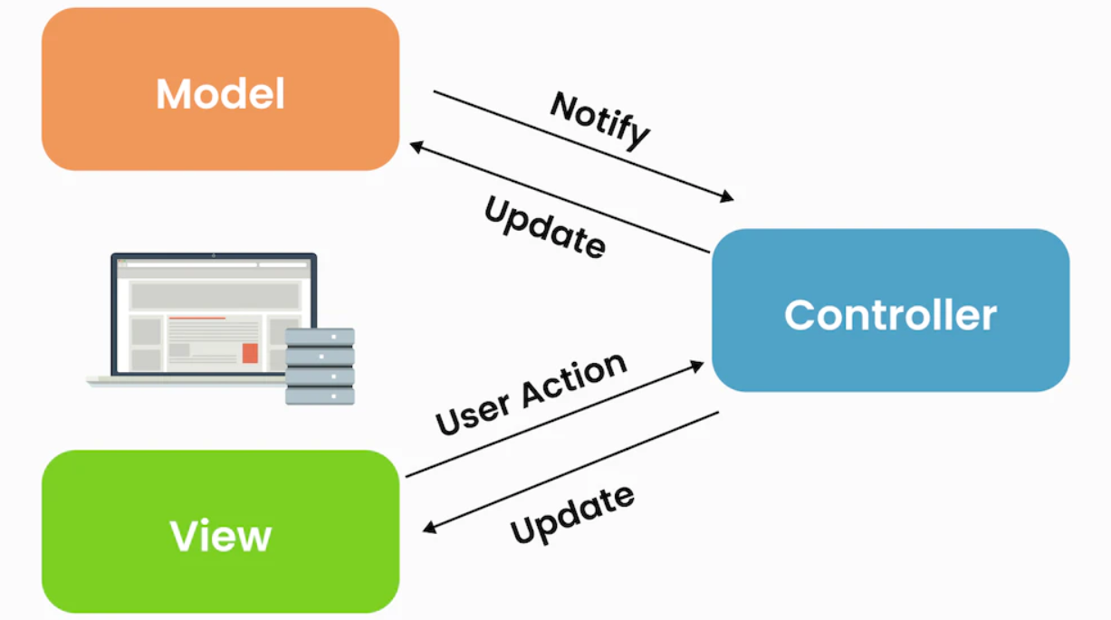
MVC Pattern

Slide 7
Why Laravel?
MVC Support and Object-Oriented Approach
Built in Authentication and Authorization
Packaging System
Multiple File System
Artisan Console
Eloquent ORM
Templating engine (Blade)
Task Scheduling
Events and Broadcasting
Testing

Slide 8
Steps to follow
Installation of PHP Local Server (i.e XAMPP)
Installation of Composer (Package manager)
Installation of Laravel Globally
Creating a new project
Installation of a code editor (VS Code)

Slide 9
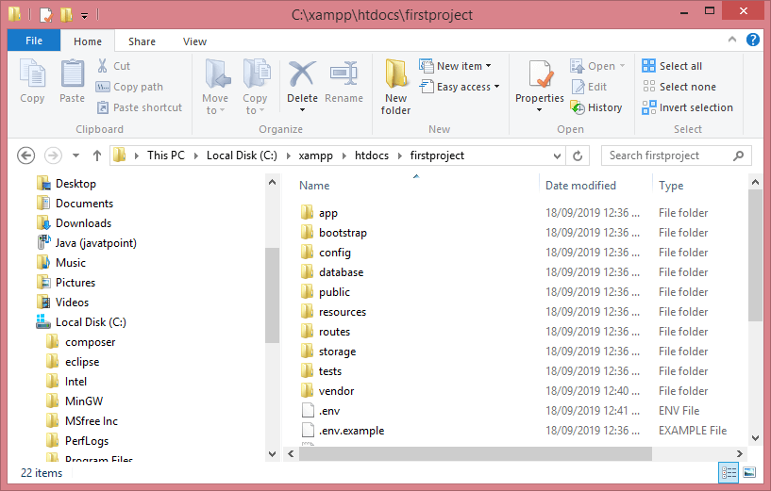
Laravel Application Structure
Once the project is created in Laravel, the application structure generated as shown in the screenshot:

Slide 10
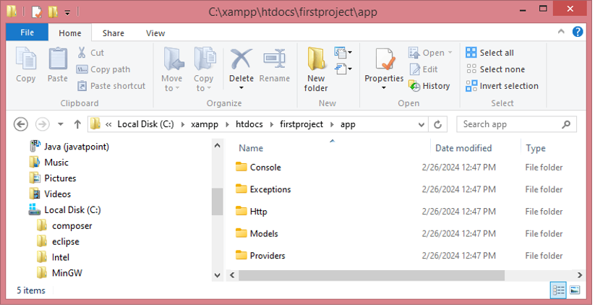
Laravel’s App Directory
Most of the code is written in the app folder.
The App folder contains the following sub-folders:
Console
Exceptions
Http
Models
Providers

Slide 11
Laravel’s App Directory
Console: This directory contains all the custom Artisan commands created using make:command.
Exceptions: This directory contains the application’s exception handler and is a good place to add custom exception classes to handle different exceptions thrown by your application.
Http: This directory contains all your controllers, middleware, views and requests.
Models: This is a new directory added since Laravel 8 to hold Model files.
Providers: This directory contains all your service providers for the application.

Slide 12
Other Directories
Bootstrap: This directory contains framework bootstrap as well as configuration files. It also contains Cache directory which contains framework generated cache files. It also contains the file app.php that initializes the scripts required for bootstrap.
Config: This directory contains all your application’s configuration files.
Database: This directory contains all database migrations and seeds.
Factories: The factories folder is used to generate a huge number of data records.
Migrations: The migrations folder is used to migrate the database in web application.
Seeds: The seeds folder contains the classes used to perform unit testing database.

Slide 13
Other Directories
Storage: This directory contains blade templates, session files, cache files and other.
Tests: This directory contains all the test files.
Vendor: This directory contains all composer dependencies.

Slide 14
Other Directories
Public: This directory contains assets like images, compiled js files and CSS. It contains the front controllers used for initializing the Laravel web application. (index.php)
Resources: This directory contains all assets, view files and CSS or LESS or SASS files. It also contains lang directory to store language files.
Routes: This directory contains all routes definitions for the application. php is the file which receives all the requests to your application and here you can redirect the requests to their respective controller methods.

Slide 15
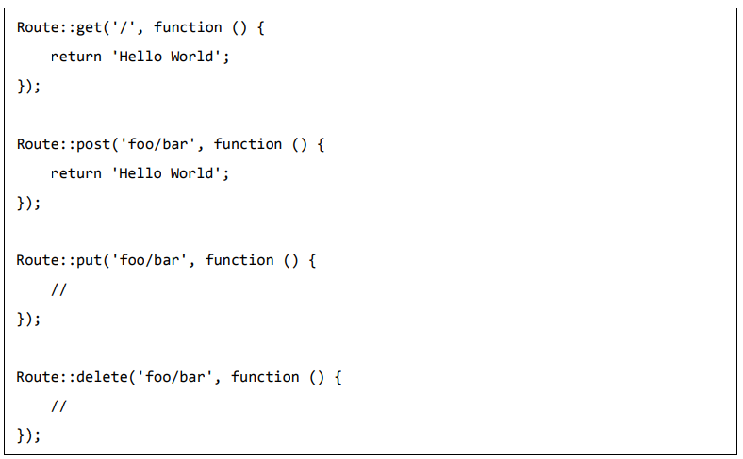
Routing in Laravel
Basic routing is meant to route your request to an appropriate controller.
routes/web.php

Slide 16
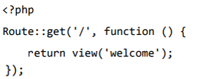
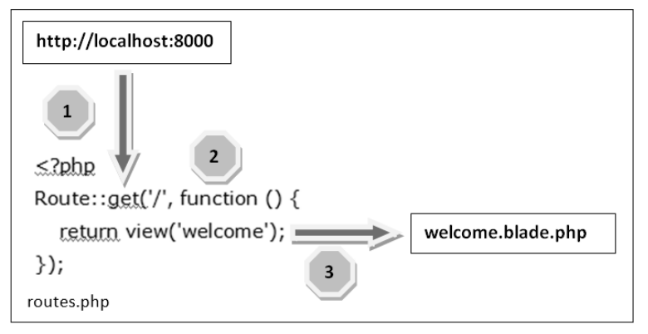
Routing in Laravel
To see the Laravel homepage with the help of routing.
routes/web.php

Slide 17
Routing in Laravel
You can also send and capture parameters passed with the URL.
Whatever argument that passed after the root URL (http://localhost:8000/ID/5), it will be stored in $id and can be used for further processing
It can be passed onto view or controller for further processing.
Route::get('name/{name}', function ($name) {
echo 'Name: '.$name;
});
Route::get('/{name?}', function ($name = null) {
$data = compact('name');
return view('home')->with($data);
});

Slide 18
Routing in Laravel
You can also send optional parameters passed with the URL.
The presence of these parameters is not necessary in the URL.
These parameters are indicated by “?” sign after the name of the parameters.
Route::get ('/user/{name?}’, function ($name = ‘Saeed’){
echo "Name: ".$name;
});

Slide 19
Blade Templates
Blade is a templating engine in a Laravel framework.
Blade templating engine provides its own structure such as conditional statements and loops.
To create a view file, save it with a .blade.php extension instead of .php extension.

Slide 20
Displaying Data
Core PHP Syntax
Blade Template Syntax
<?php echo $name; ?>
{{ $name }}
{!! $name !!}
Adding ‘!!’ with ‘{{‘ executes/decodes html tags.

Slide 21
Blade Conditional Directives
@if, @elseif, @else, and @endif.
@unless, @endunless.
@isset, @endisset
@if($name == "")
{{"Name is empty"}}
@elseif($name == "Saeed")
{{"Welcome Saeed"}}
@else
{{"Welcome Guest"}}
@endif

Slide 22
Blade Looping Directives
@for and @endfor.
@while and @endwhile.
@foreach and @endforeach.
@break and @continue.
@for ($i=1;$i<10;$i++)
<h2>{{$i}}</h2>
@endfor
@php
$i = 1;
@endphp
@while ($i<=10)
<h2>{{$i}}</h2>
@php $i++; @endphp
@endwhile

Slide 23
Other Directives
For Comments: {{-- Comments goes here --}}
For including: @include
For raw PHP: @php and @endphp

Slide 24
Layout Blade Directives
@yield directive is used to display the contents of a given section.
@section directive defines a section of a content.
@extends directive is to specify which layout the child view should “inherit”.

Slide 25
Layout Blade Directives
To render the complete stack contents, pass the name of the stack to the @stack directive
@push and @endpush is used to push data into the stack.

Slide 26
Laravel Controller
Controller are class based php files.
Controllers can group related request handling logic into a single class.
Brings OOP functionalities.
Types of Controller:
1. Basic Controllers
2. Single Action Controllers
3. Resource Controllers (CRUD)

Slide 27
Controller Commands
Basic Controller:
php artisan make:controller ControllerName
DemoController.php
<?php
namespace App\Http\Controllers;
use Illuminate\Http\Request;
class DemoController extends Controller
{
public function index(){
return view('home');
}
}
web.php
<?php
use Illuminate\Support\Facades\Route;
use App\Http\Controllers\DemoController;
Route::get('/', [DemoController::class, 'index']);

Slide 28
Controller Commands
Single Action Controller:
php artisan make:controller ControllerName –invokable
Resource Controller:
php artisan make:controller ControllerName –resource

Slide 29
References
https://www.javatpoint.com/laravel
https://www.tutorialspoint.com/laravel
https://www.wscubetech.com/

Slide 30
Thank You!!!

